Slide 1
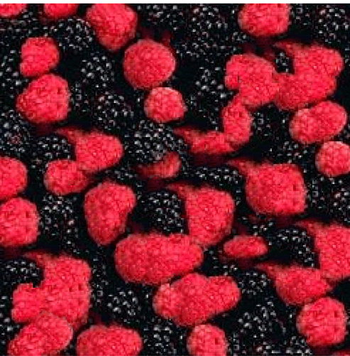
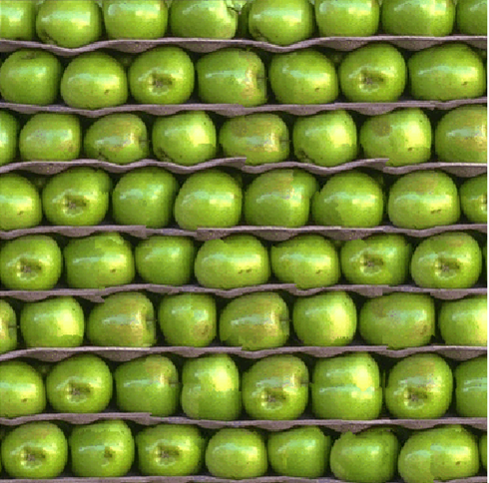
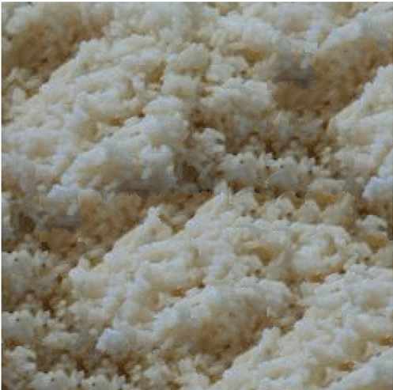
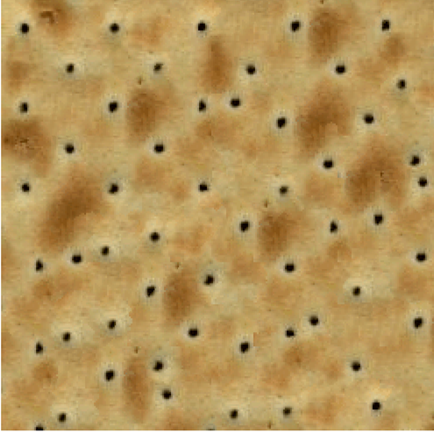
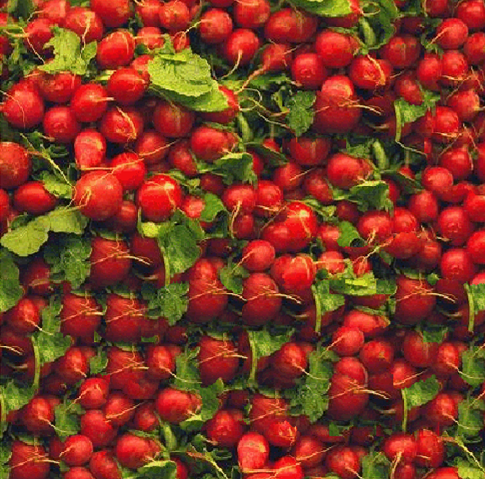
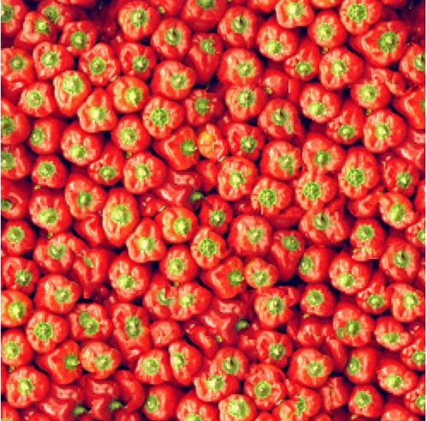
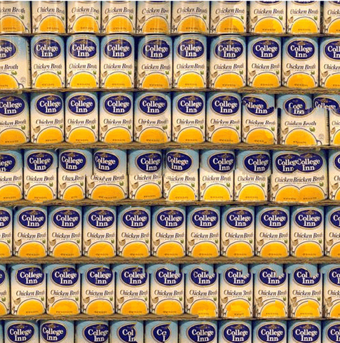
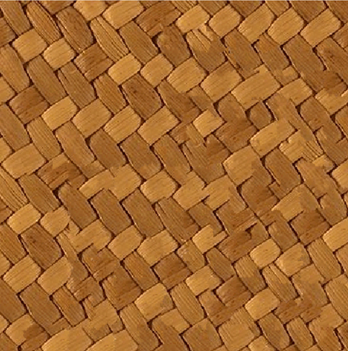
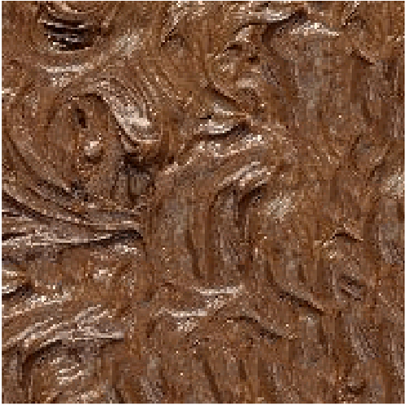
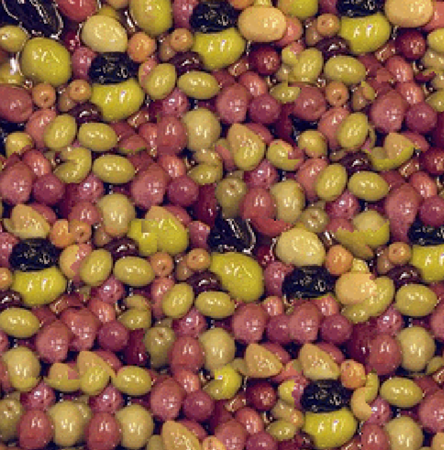
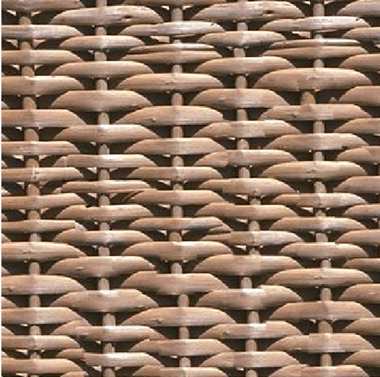
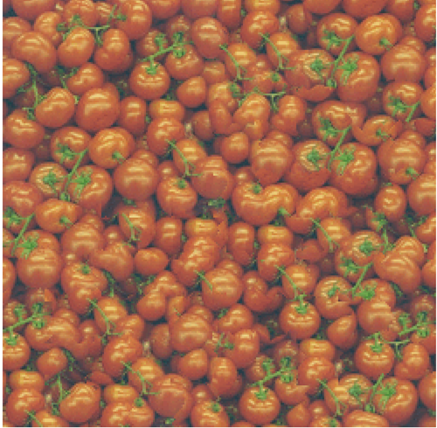
CS663 Course Project
Image Quilting for Texture Synthesis and Transfer
Group members:
Aditya Kabare, 21D070009
Anuj Gupta, 21D070014
Mayank Gupta, 210101002

Slide 2
Texture Synthesis Process
Images are formed by stitching in raster scan order
Choose a block from the set of all overlapping blocks of specified size which minimizes error in overlap region

Slide 3
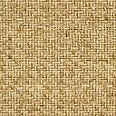
Find the minimum error path in the overlap region to make the optimal cut
The cut block is stitched together with the image formed so far
Block size and overlap factor in both directions is chosen by user

Slide 4
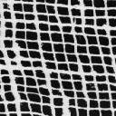
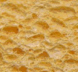
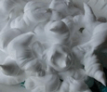
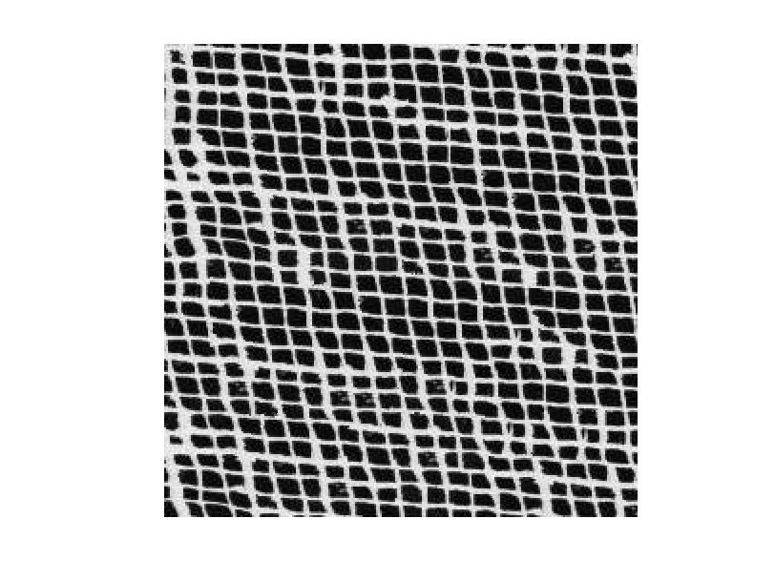
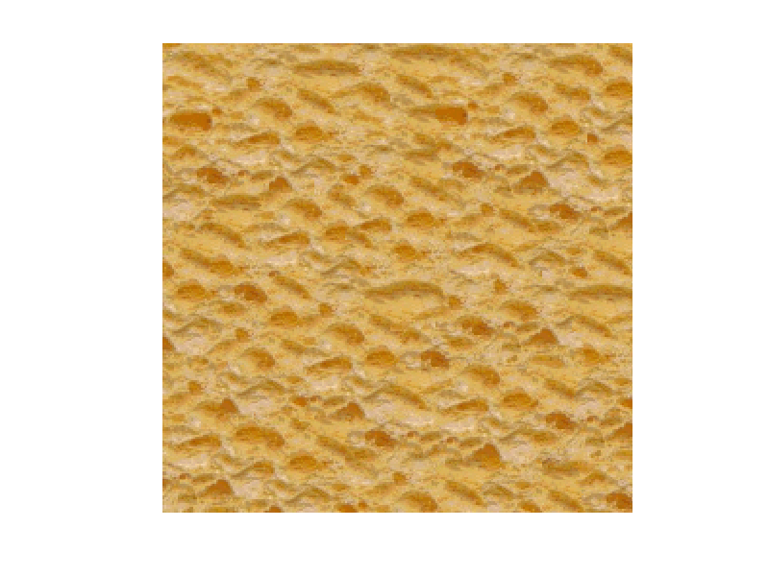
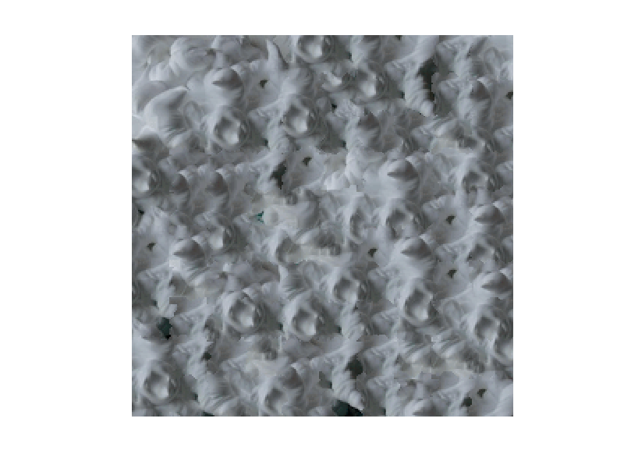
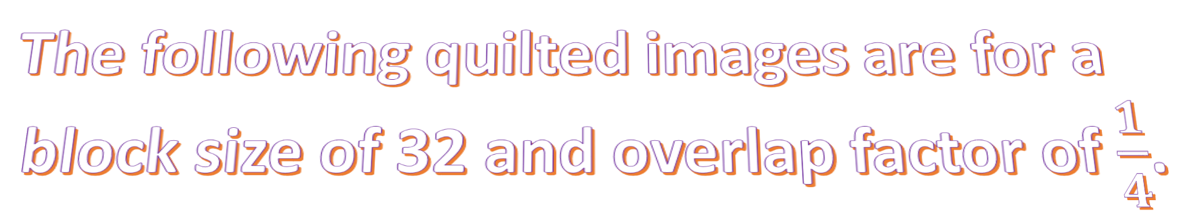
The following quilted images are for a
block size of 32 and overlap factor of $\frac{1}{4}$.

Slide 5
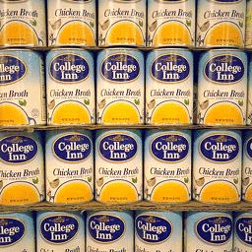
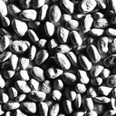
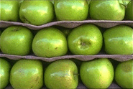
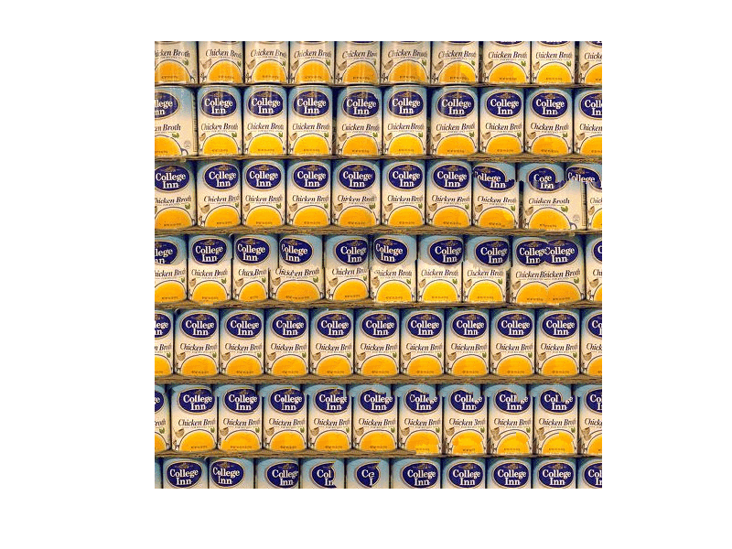
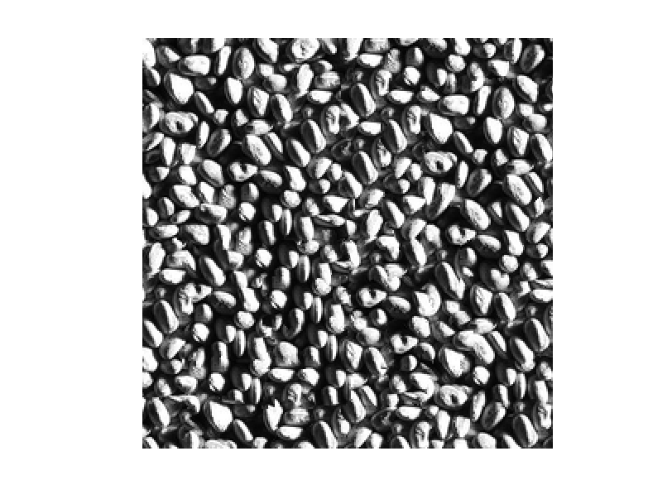
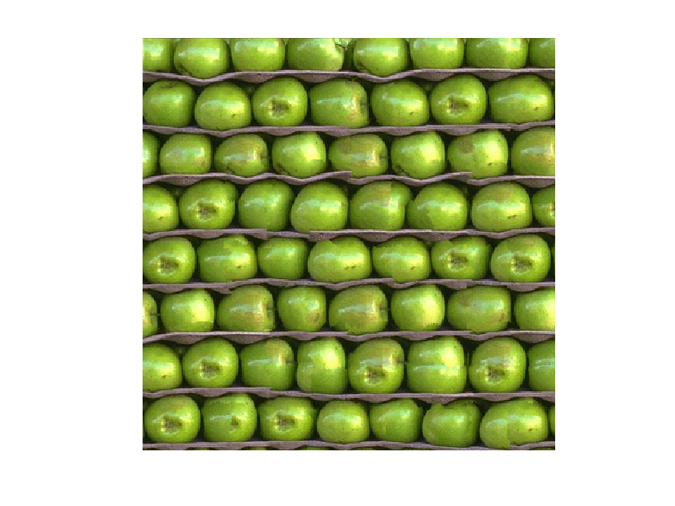
256x256
128x128
124x185
248x248
357x357
496x496

Slide 6
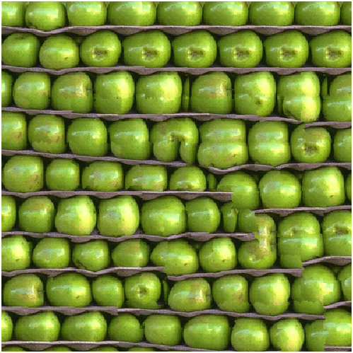
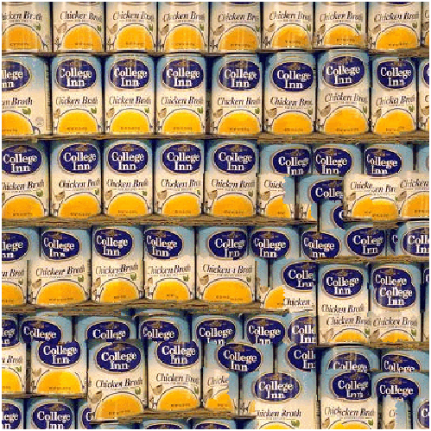

These images were made with an overlap factor of $\frac{1}{6}$, which was
mentioned in the paper. $\frac{1}{4}$has better results than $\frac{1}{6}$overlap
factor since the overlap is higher.

Slide 7
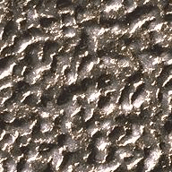
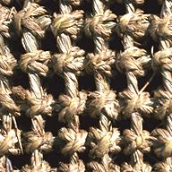
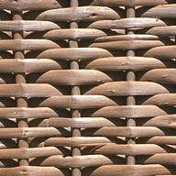
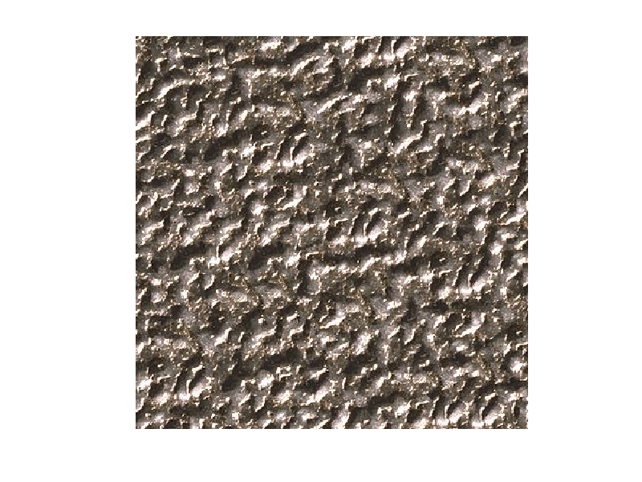
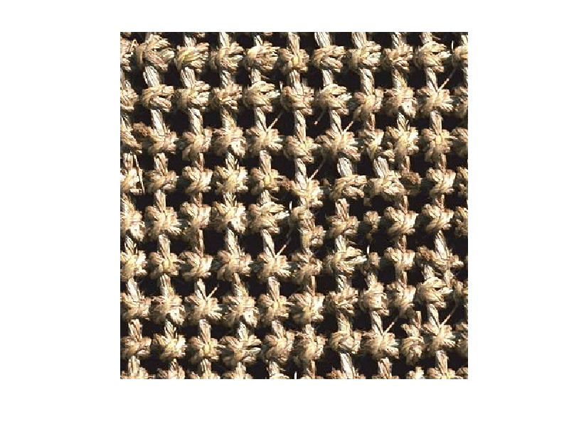
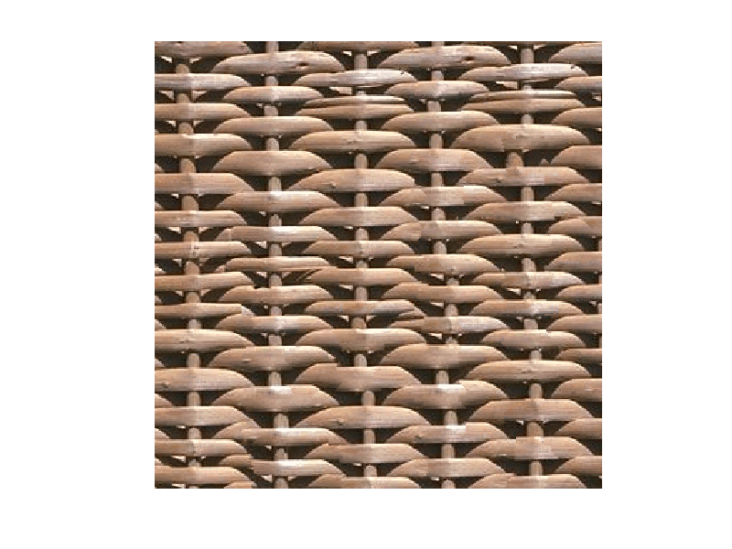

Slide 8
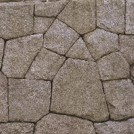
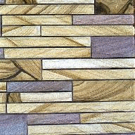
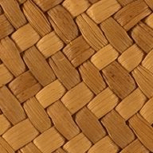
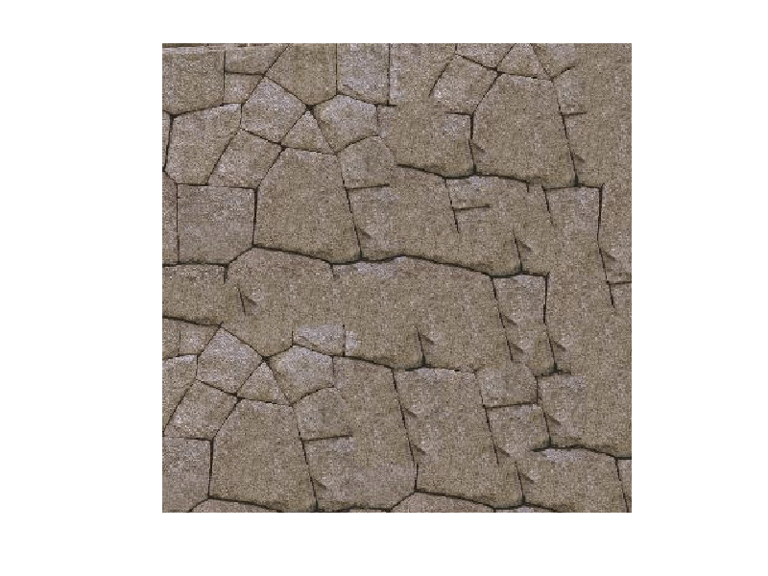
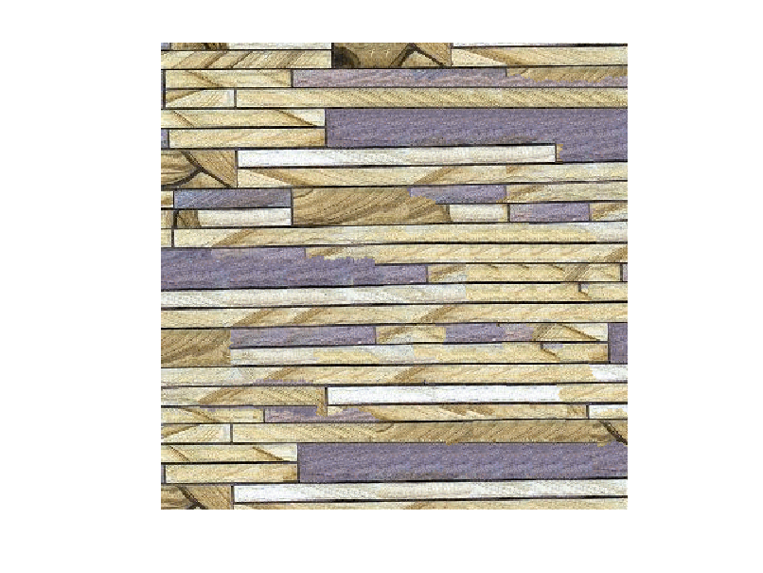
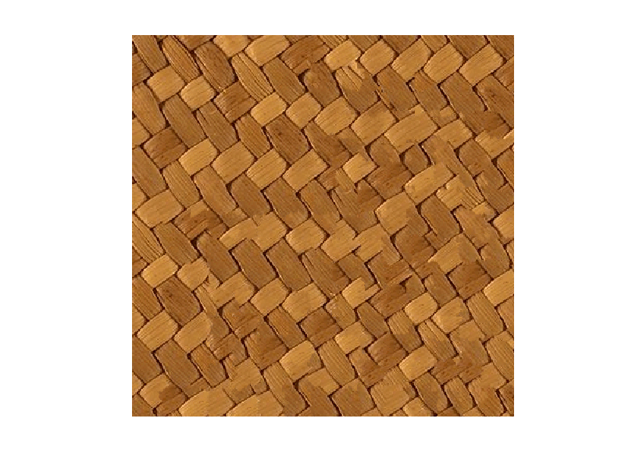

Slide 9

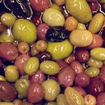
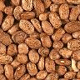
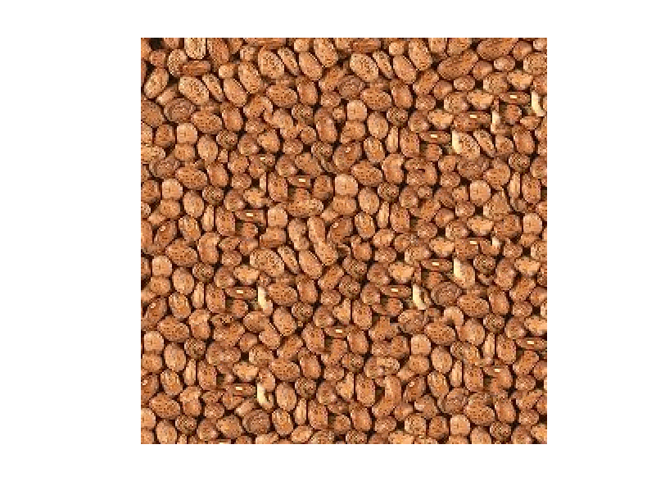
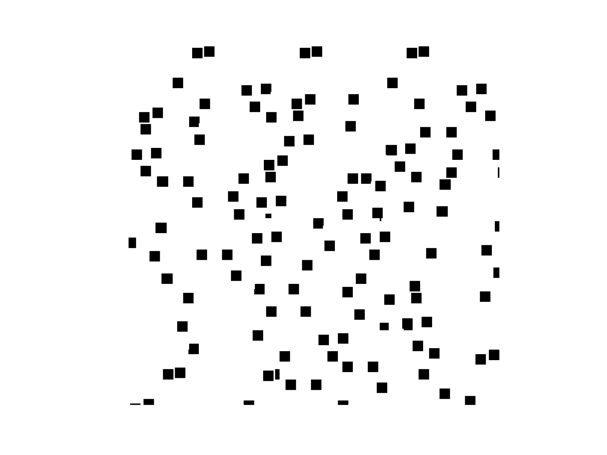
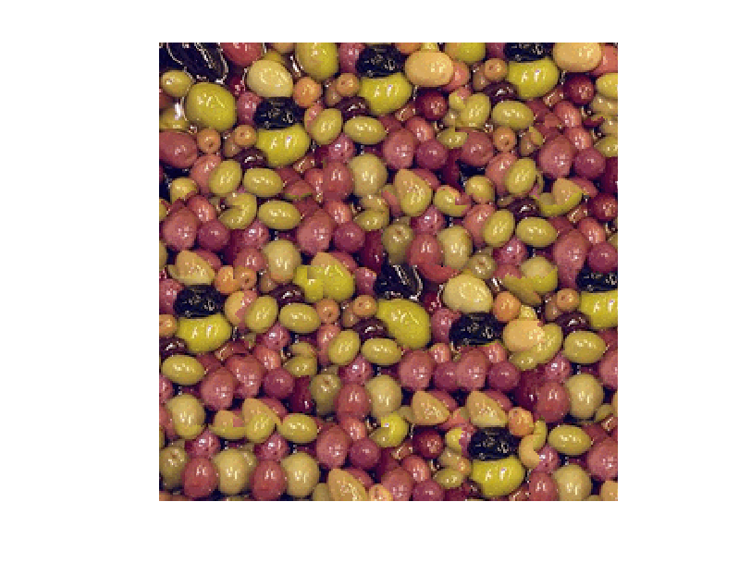

Slide 10
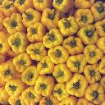
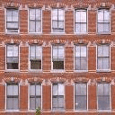
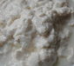
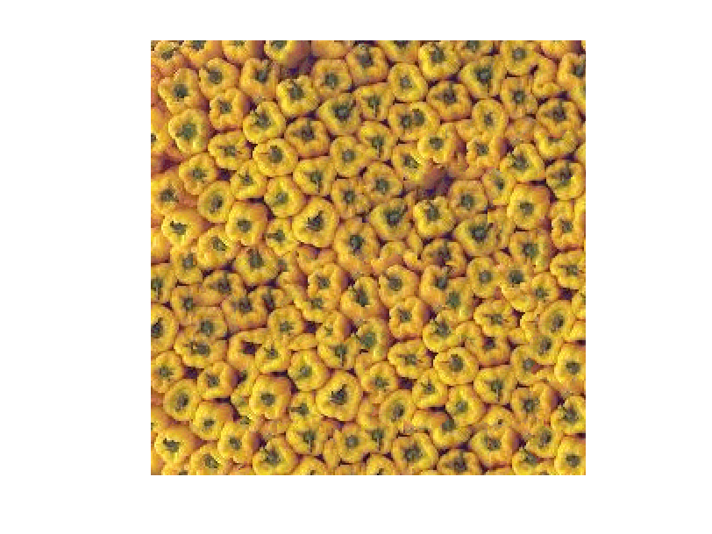
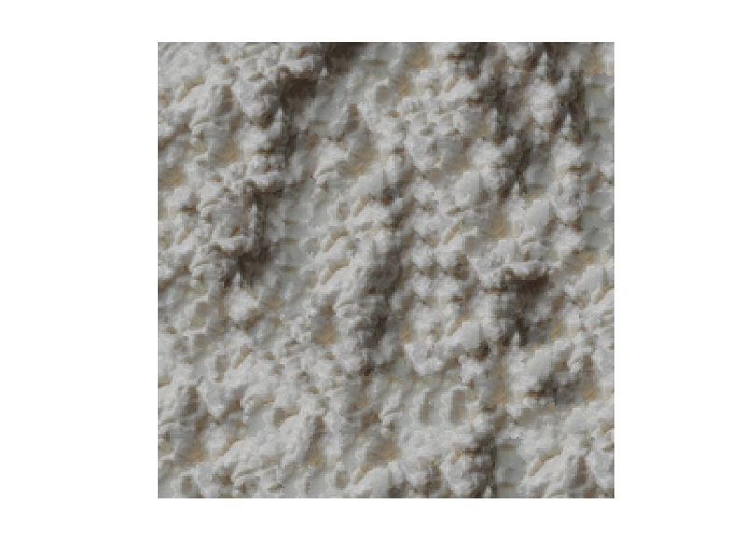


Slide 11







Slide 12







Slide 13







Slide 14



Slide 15

Texture Transfer
Texture Transfer is a method of transferring a stylized texture from a source image to a target image while maintaining the details and characteristics as accurately as possible.
We completely recreated the target image which manifests as completely made out of the texture.
We divided the source texture into multiple overlapping blocks. Different blocks covered different corresponding details of the target image.

Slide 16

Algorithm
Converted the RGB images to YCbCr since luminance captures the details between the source and target.
Used histogram equalisation of both images to get the maximum correlation between the two.
We iterated over the overlapping blocks of source texture to get the best matching block which we get by minimising an error function containing the weighted mean of overlapping regions and squared difference between source and target images.
We used our Image Quilting algorithm to merge the blocks to the result images.
The parameters involved are alpha = 0.1 (for weighed mean in error) and block size.

Slide 17
Without Histogram equalization of only Y on the YCbCr image | After histogram equalization of only Y on the YCbCr image

Slide 18
From the above slide:
The YCbCr images are closer for
those cases when the luminescence are
equalised.
Luminescence is better than RGB as
it gives accurate texture transfer for
cases when the pixel vectors in RGB
form a basis (they are independent)

Slide 19






Iterations with different block sizes
Iteration 1
Iteration 2
Iteration 3

Slide 20

This image doesn’t have
distinct lips. The
luminescence around the
lips is similar. Thus, they get
smudged. It can be seen that
the contrast is high in this
image. The following slide
contains the image without
histeq of the luminescence.

Slide 21

Iteration 1
Iteration 2

Slide 22



Iteration 1
Iteration 2
Iteration 3

Slide 23



Iteration 1
Iteration 2
Iteration 3

Slide 24
Things that didn’t work
Texture transfer for RGB images was not giving accurately results.
Tried converting images format to HSI, using histogram equalised intensity value and comparing the source and target image intensities. That also didn’t work well.
Tried converting color images to grayscales and used the intensity mappings with color maps to process and later converting them back to color. That also didn’t work well.

Slide 25
Thank You!
Have a nice day!
Group members:
Mayank Gupta, 210101002
Anuj Gupta, 21D070014
Aditya Kabare, 21D070009

